Slide 1
Research in Video Encoding and Streaming
ESTR4998 – Oral Presentation
Weijia Zheng, 1155124322
Department of Information Engineering, CUHK
December 10, 2021

Slide 2
Outline
Brief Introduction
A Short Literature Review On Throughput Prediction
Our Work of the Problem
Empirical Conditional Probability Method
Theoretical Motivation
Method in Details
Point Estimate
Interval Estimate
Numerical Result
Known Defect of Our Model
Conclusion

Slide 3
Brief Introduction - An Overall Picture of Video Encoding and Streaming
Video frames generated at the uploader side are sent to the server.
Server then made the video trace received into different copies as different players may have different network quality and demands.
We will mainly focus on the uploading part.
Live Video Uploader
Video Trace
Data
Video Trace
Data
Vid Trace
Vid Trace
Vid Trace
Uplink Network
Player 1
Server
Downlink Network
Adapt/decide
Encoding Bitrate
Player 2
…

Slide 4
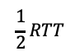
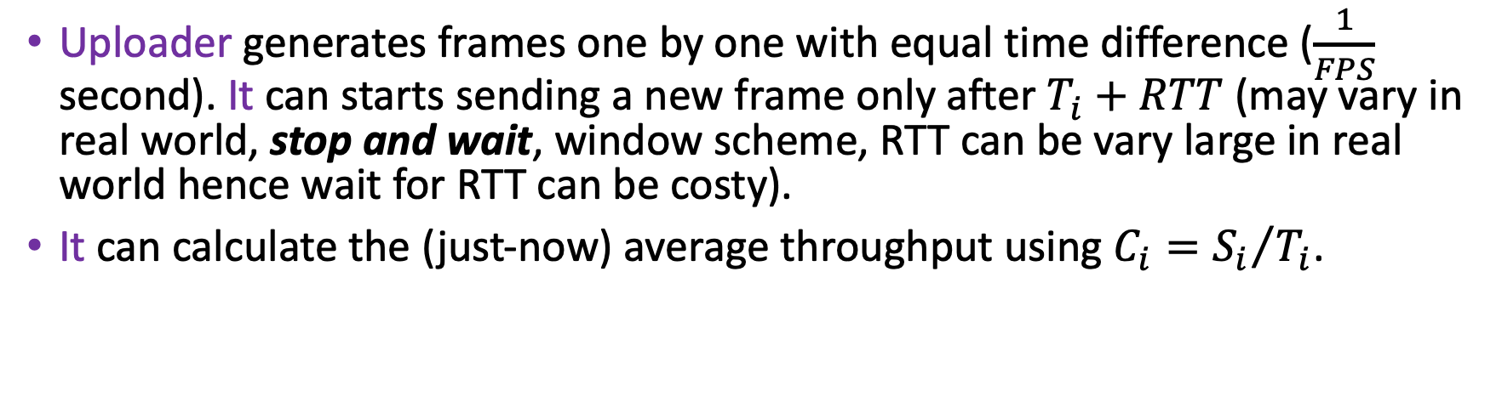


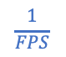
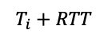
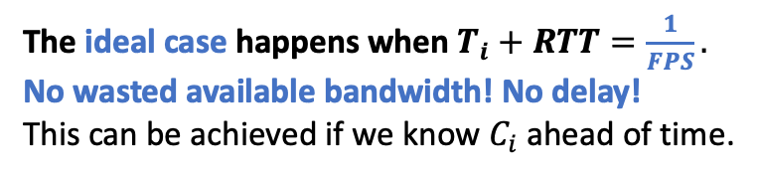
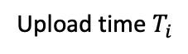
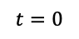
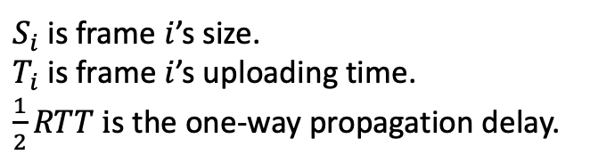
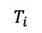
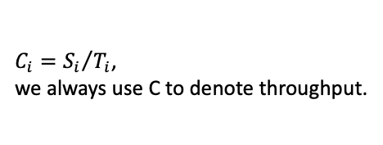
Brief Introduction - How Do Frames Be Transmitted?
Uploader generates frames one by one with equal time difference ($\frac{1}{FPS}$ second). It can starts sending a new frame only after $T_{i}+RTT$ (may vary in real world, stop and wait, window scheme, RTT can be vary large in real world hence wait for RTT can be costy).
It can calculate the (just-now) average throughput using $C_{i}={S_{i}}/{T_{i}}$.
$$\frac{1}{2}RTT$$
$$S_{i}$$
$S_{i}$is frame $i$’s size.
$T_{i}$is frame $i$’s uploading time.
$\frac{1}{2}RTT i$s the one-way propagation delay.
Server
time
$$\frac{1}{FPS}$$
The ideal case happens when $T_{i}+RTT=\frac{1}{FPS}.$
No wasted available bandwidth! No delay!
This can be achieved if we know $C_{i}$ ahead of time.
$$S_{i}$$
Uploader
$$t=0$$
$$T_{i}$$
$$T_{i}+RTT$$
time
Upload time $T_{i}$
$C_{i}={S_{i}}/{T_{i}}$,
we always use C to denote throughput.

Slide 5
A Short Literature Review on Throughput Prediction
Here we selected among nowadays’ noticeable prediction algorithms into these following categories.
Mean Based Algorithms (Arithmetic Mean, Moving Average…)
Regression Algorithms (Linear Regressions, AR…)
Machine Learning Based Algorithms (RNN, LSTM, SVM, etc.)
Surprisingly, this problem has not yet been taken over by ML, some commented “exploding gradient problem makes the (ML) model unstable.” (D. Lee et al, 2020) Besides, history-based methods have attracted more attention because of high accuracy and the convenience of obtaining correct history data.

Slide 6
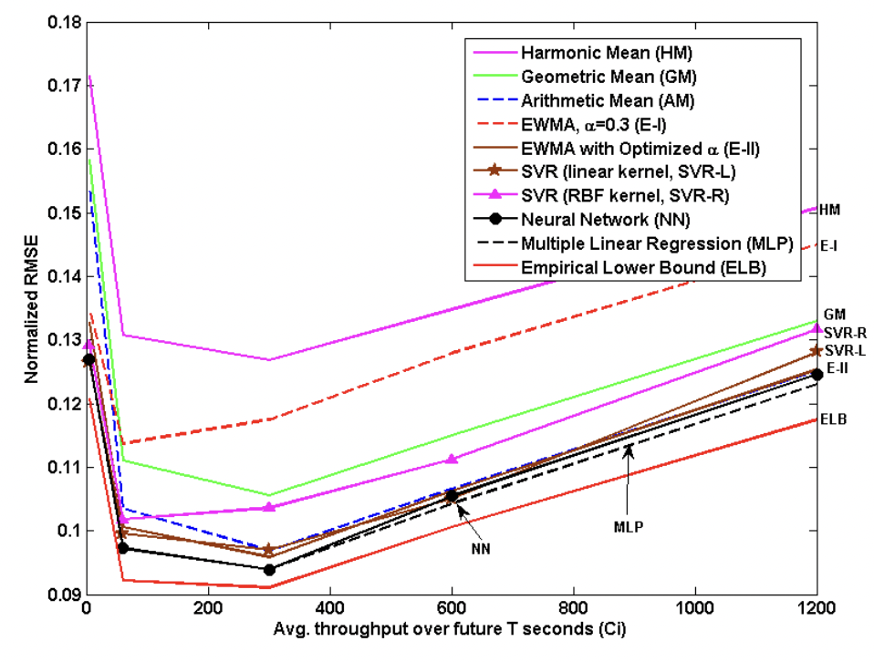
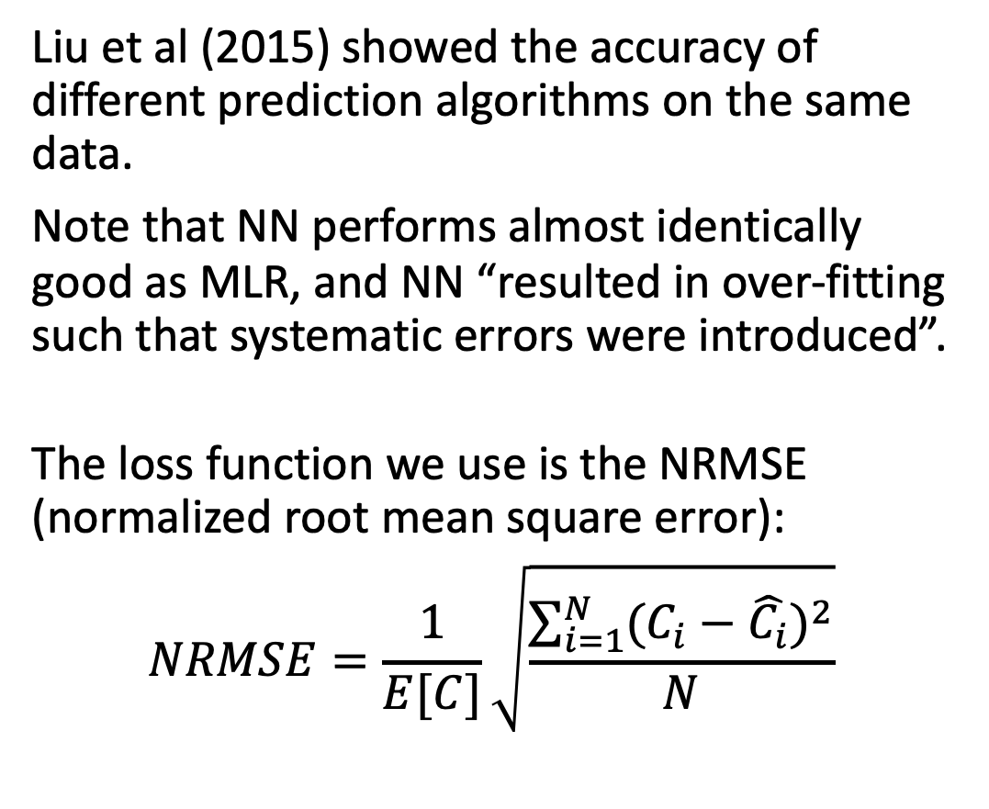
A Short Literature Review on Throughput Prediction
Liu et al (2015) showed the accuracy of different prediction algorithms on the same data.
Note that NN performs almost identically good as MLR, and NN “resulted in over-fitting such that systematic errors were introduced”.
The loss function we use is the NRMSE (normalized root mean square error):
$$NRMSE=\frac{1}{E[C]}\sqrt{\frac{\sum_{i=1}^{N}{{(C_{i}−\hat{C_{i}})}^{2}}}{N}}$$

Slide 7
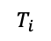
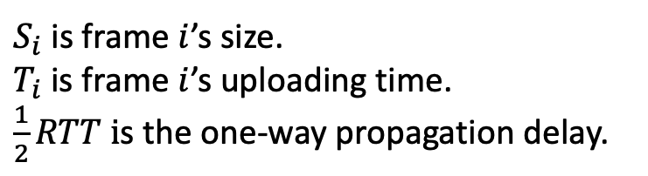
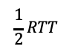
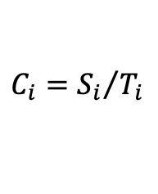


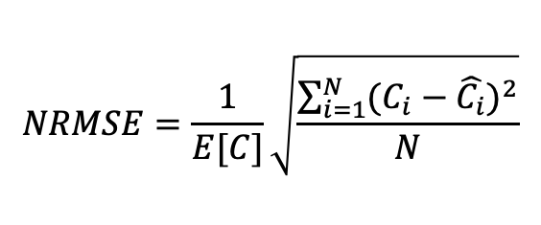
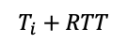
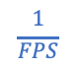
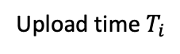
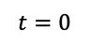
Our Work on this Problem
$$\frac{1}{2}RTT$$
$$S_{i}$$
$S_{i}$is frame $i$’s size.
$T_{i}$is frame $i$’s uploading time.
$\frac{1}{2}RTT i$s the one-way propagation delay.
Server
time
$$\frac{1}{FPS}$$
$$NRMSE=\frac{1}{E[C]}\sqrt{\frac{\sum_{i=1}^{N}{{(C_{i}−\hat{C_{i}})}^{2}}}{N}}$$
$$S_{i}$$
Uploader
$$t=0$$
$$T_{i}$$
$$T_{i}+RTT$$
time
$$C_{i}={S_{i}}/{T_{i}}$$
Upload time $T_{i}$
We proposed a new throughput predicting method.
We coded a frame-uploading simulator to emulate the uploading process and to test our model, counting the frame loss rate (we do not distinguish between different types of frames for simplicity) and having different minimal frame size as constraints.

Slide 8
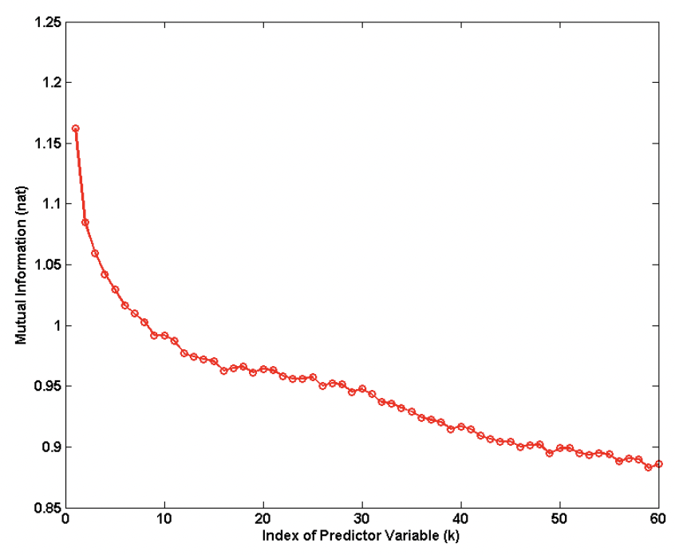
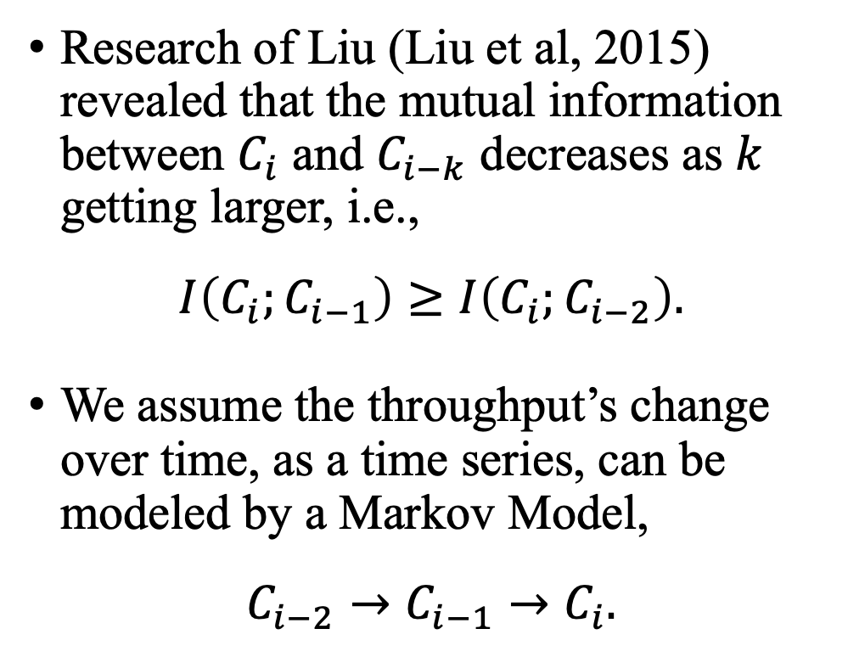
Empirical Conditional Probability Method - Theoretical Motivation
Research of Liu (Liu et al, 2015) revealed that the mutual information between $C_{i}$ and $C_{i−k}$ decreases as $k$ getting larger, i.e.,
$$I\left(C_{i};C_{i−1}\right)≥I\left(C_{i};C_{i−2}\right).$$
We assume the throughput’s change over time, as a time series, can be modeled by a Markov Model,
$$C_{i−2}→C_{i−1}→C_{i}.$$

Slide 9
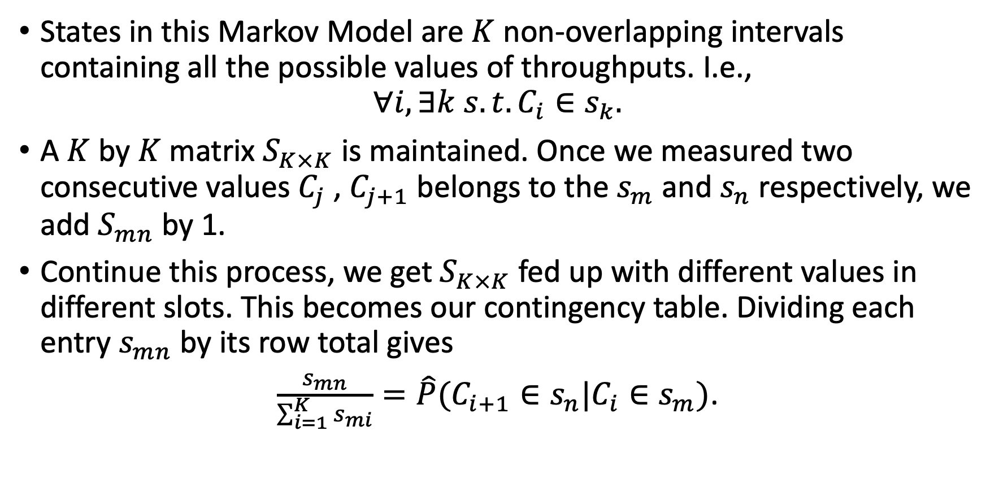
Empirical Conditional Probability Method - Method in Details
States in this Markov Model are $K$ non-overlapping intervals containing all the possible values of throughputs. I.e.,
$$∀i, ∃k s.t. C_{i}∈s_{k}.$$
A $K$ by $K$ matrix $S_{K×K}$ is maintained. Once we measured two consecutive values $C_{j}$ , $C_{j+1}$ belongs to the $s_{m}$ and $s_{n}$ respectively, we add $S_{mn}$ by 1.
Continue this process, we get${ S}_{K×K}$ fed up with different values in different slots. This becomes our contingency table. Dividing each entry $s_{mn}$ by its row total gives
$\frac{s_{mn}}{\sum_{i=1}^{K}{s_{mi}}}=\hat{P}(C_{i+1}∈s_{n}|C_{i}∈s_{m})$.

Slide 10
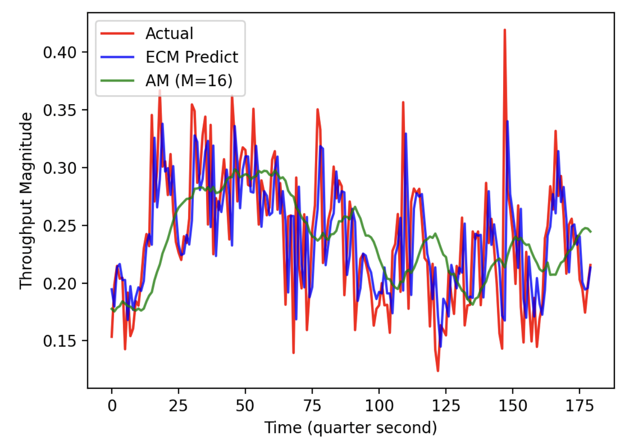
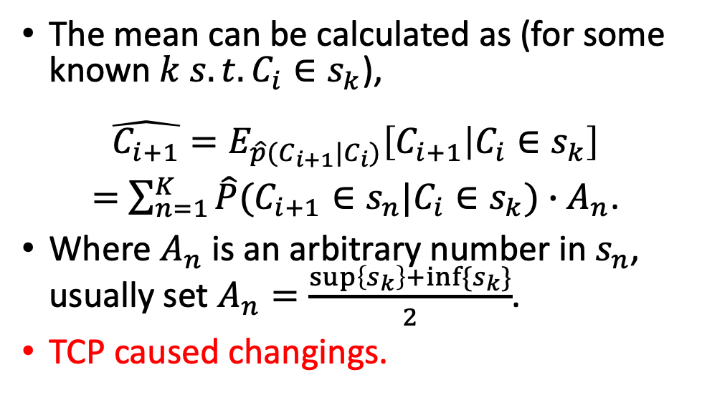
Empirical Conditional Probability Method - Method in Details: Point Estimate
Unlike usual Markov Models who often choose a state with a maximal transition probability, based on some simulations, we found choosing the empirical conditional mean of the model fits the data better.
The mean can be calculated as (for some known $k s.t.C_{i}∈s_{k}$),
$$\hat{C_{i+1}}=E_{\hat{p}(C_{i+1}|C_{i})}\left[C_{i+1} | C_{i}∈s_{k}\right]$$
$=$ $\sum_{n=1}^{K}{\hat{P}(C_{i+1}∈s_{n}|C_{i}∈s_{k})∙A_{n}\text{.}}$
Where $A_{n}$ is an arbitrary number in $s_{n}$, usually set $A_{n}=\frac{\sup\left\{s_{k}\right\}+inf⁡\{s_{k}\}}{2}$.
TCP caused changings.

Slide 11
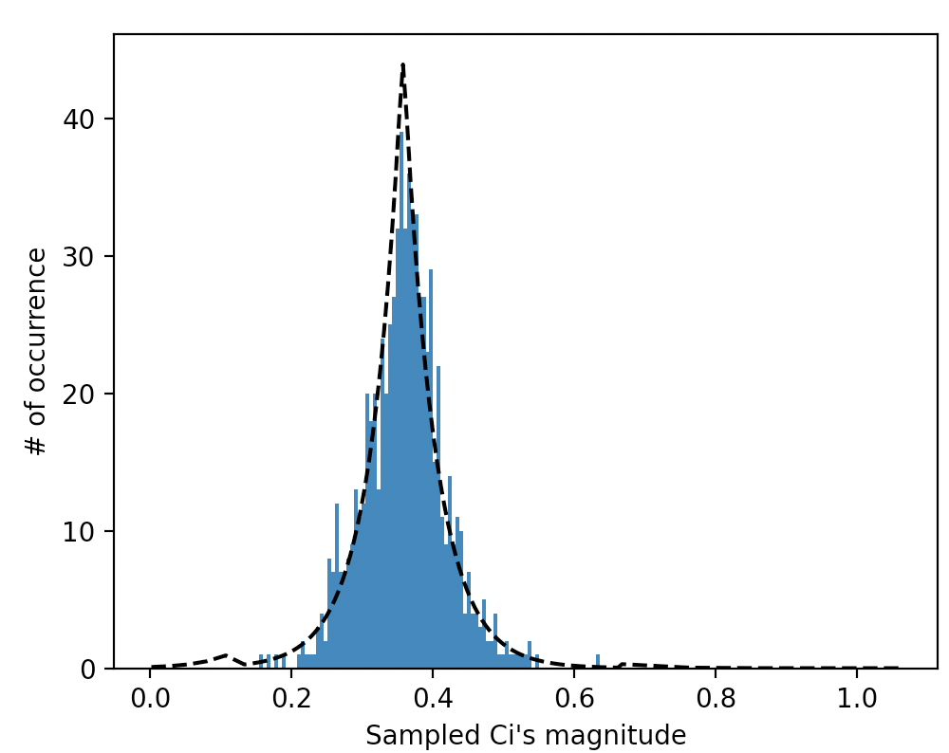
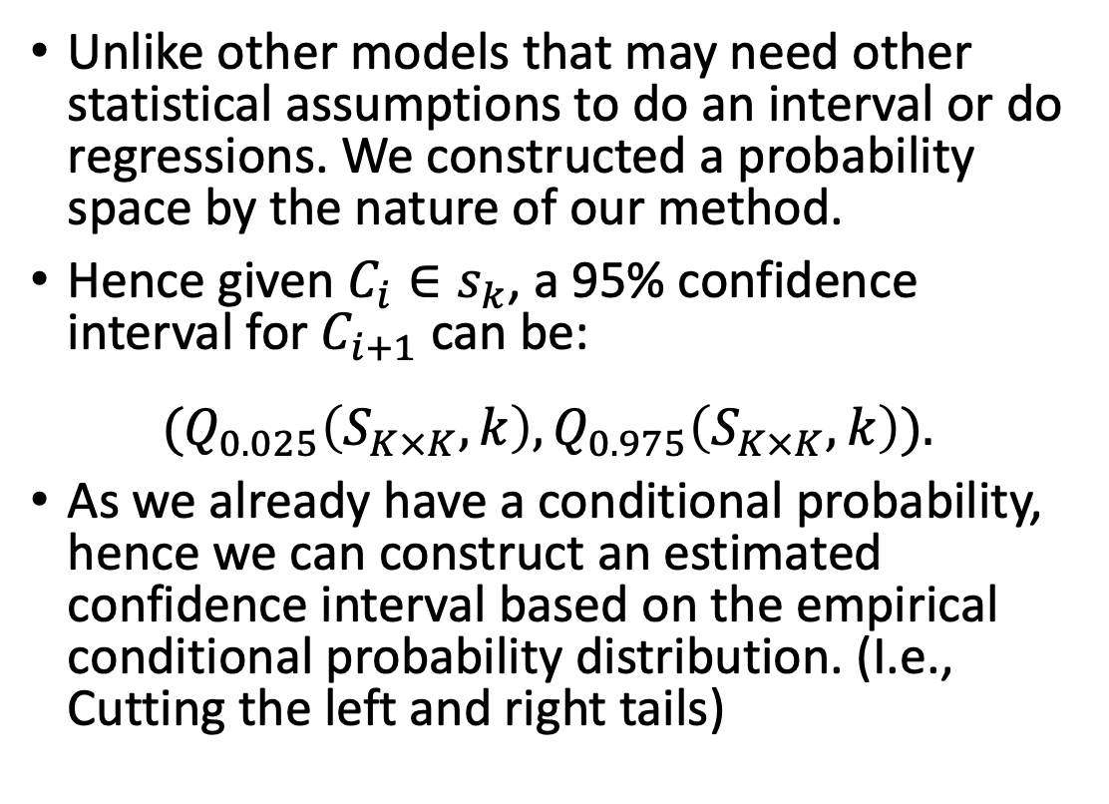
Empirical Conditional Probability Method - Method in Details: Interval Estimate
Unlike other models that may need other statistical assumptions to do an interval or do regressions. We constructed a probability space by the nature of our method.
Hence given $C_{i}∈s_{k}$, a 95% confidence interval for $C_{i+1}$ can be:
$${(Q}_{0.025}\left(S_{K×K},k\right),Q_{0.975}\left(S_{K×K},k\right)).$$
As we already have a conditional probability, hence we can construct an estimated confidence interval based on the empirical conditional probability distribution. (I.e., Cutting the left and right tails)
Take out and plot a row and in our contingency table $S_{K×K}.$
Confidence Interval

Slide 12
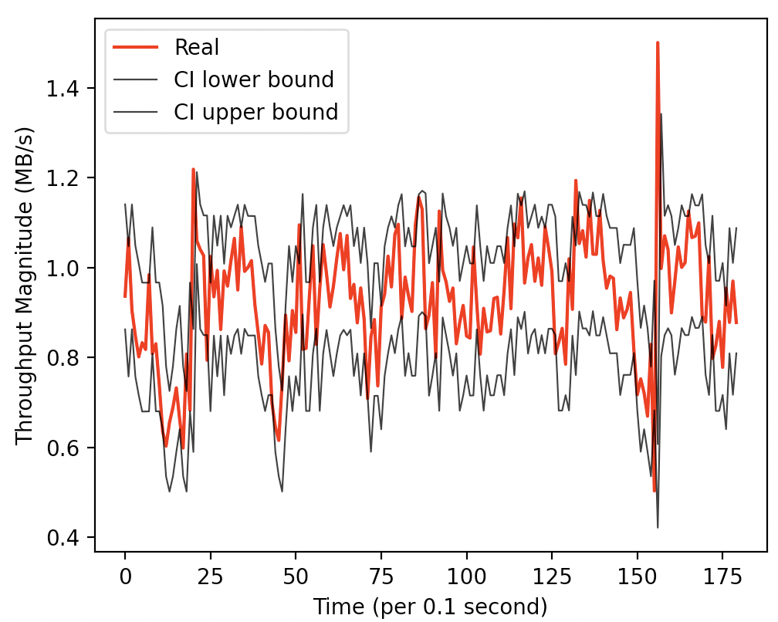
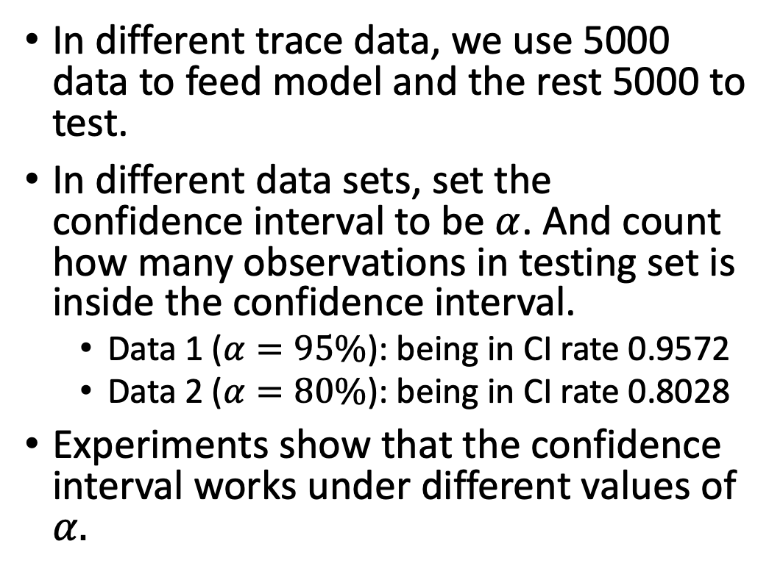
Numerical Result - Interval Estimate
In different trace data, we use 5000 data to feed model and the rest 5000 to test.
In different data sets, set the confidence interval to be $α$. And count how many observations in testing set is inside the confidence interval.
Data 1 ($α=95\%$): being in CI rate 0.9572
Data 2 ($α=80\%$): being in CI rate 0.8028
Experiments show that the confidence interval works under different values of $α.$
Data 2 Screenshot

Slide 13
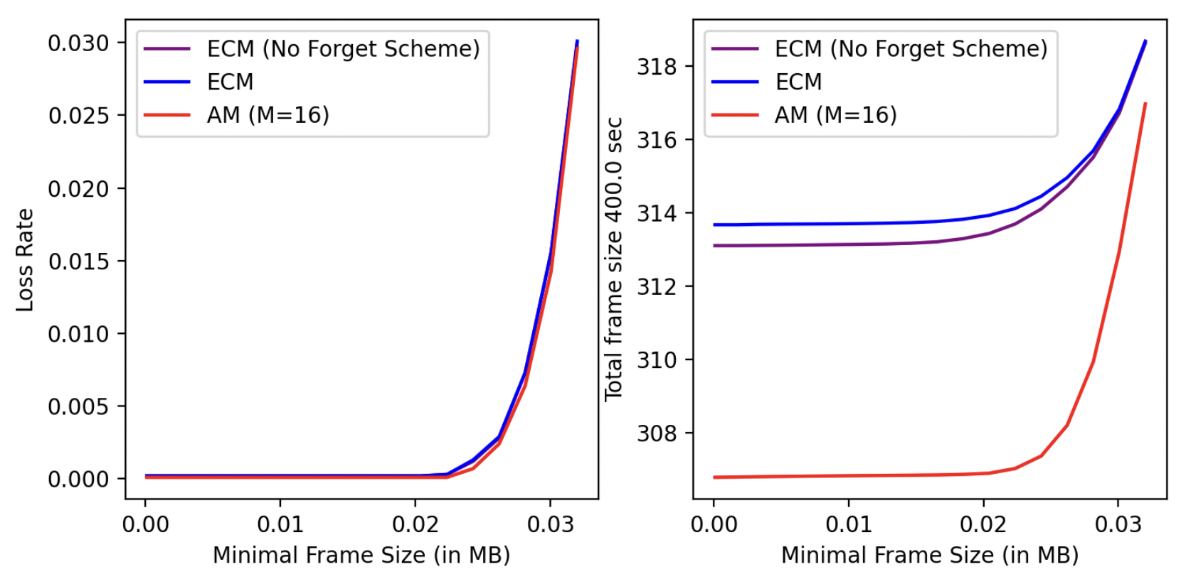
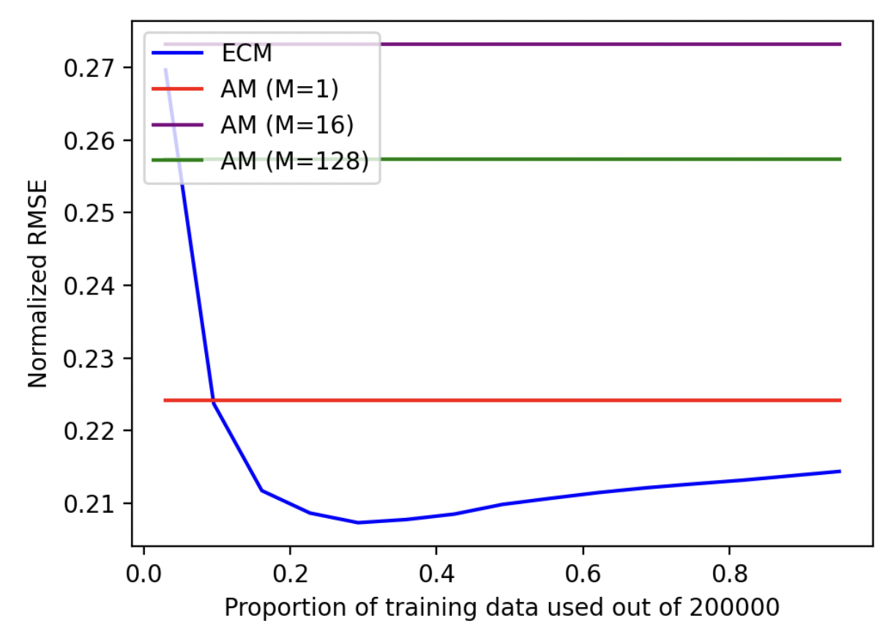
Numerical Result - Point Estimate in Simulator
Comparing with another algorithm, Arithmetic Mean in network throughput trace data (left) and in simulator (right), our approach (in blue) outperforms.
Comparing with AM algorithm, we obtain lower error in predicting.
Comparing with AM algorithm, our approach can utilize available bandwidth more.

Slide 14
Defect in Our Model
Our model is a heuristic model, based on an assumption that it is valid to model network throughput series as a Markov process. Hence may lack very powerful theoretical support and robustness at this stage. Especially when FPS grows higher.
Different observation should have different importance (because they have different mutual information), but in our model all data are regarded as a “1” added to some entry with no difference.

Slide 15
Conclusion
A good prediction of network throughput helps video streaming experience. We proposed a new history-based method of predicting throughput based on empirical conditional probability by applying Markov process.
We use the empirical conditional mean as the point estimator, and the constructed empirical conditional probability for a confidence interval estimate.
In simulations, this method outperforms Arithmetic Mean in NRMSE (about 10% off) and utilization rate of available bandwidth. However, it still have some defects such as weak robustness.

Slide 16
Reference
Y. Liu and Y. B. Lee, "An Empirical Study of Throughput Prediction in Mobile Data Networks," 2015 IEEE Glob. Commun. Conf., pp. 1–6, 2016, doi: 10.1109/glocom.2015.7417858.
D. Lee, D. Lee, M. Choi, and J. Lee, “Prediction of Network Throughput using ARIMA”, ICAIIC 2020.
“ACM Multimedia 2019 Grand Challenge -- Live Video Streaming”, website: https://www.aitrans.online/MMGC/.

